Slide 1
Background & Motivation
2025-2026 FITE 4801: FINAL YEAR PROJECT
MULTI-AGENT SYNERGISTIC FRAMEWORK FOR CRYPTOCURRENCY INVESTMENT
fyp 25039
By Qian Yifei (Fintech)
3035973880
Notes:
Good afternoon, professors. This is Nora. Today I’m glad to introduce my final year project to you and my topic is multi-agent synergistic framework for cryptocurrency investment.

Slide 2
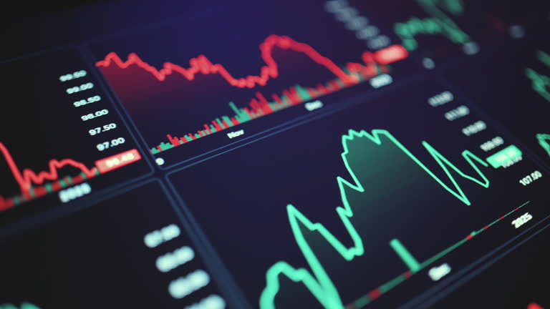
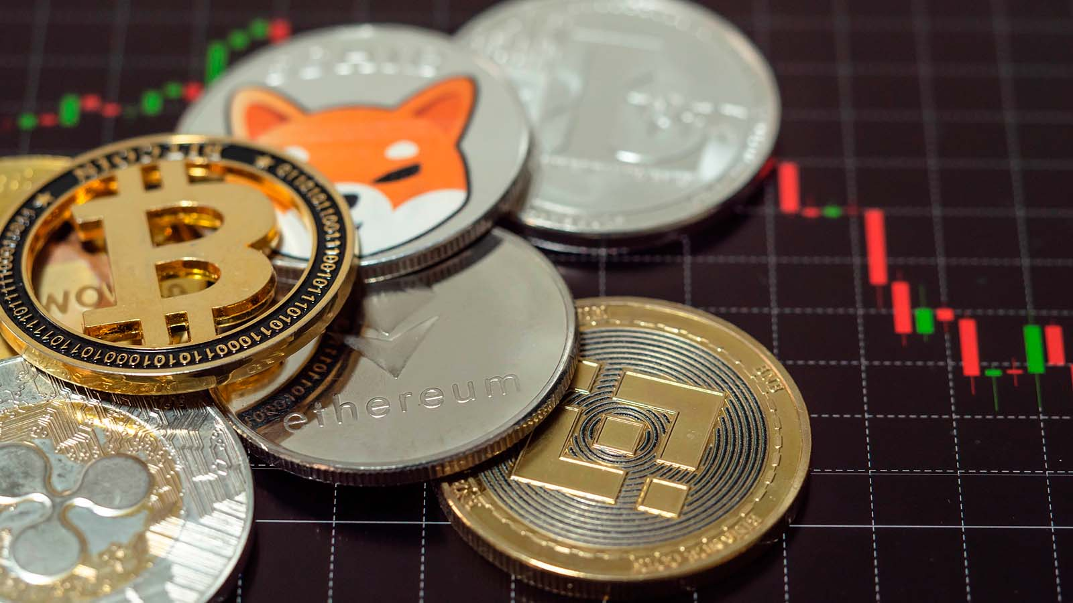
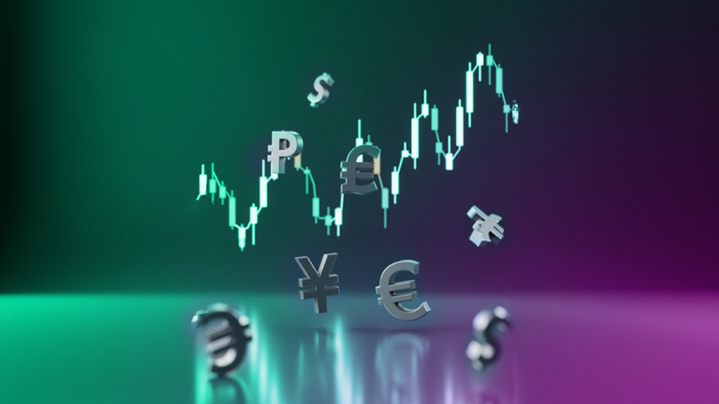
Background & Motivation
24/7 Highly Volatile
Notes:
Good afternoon, professors. This is Nora. Today I’m glad to introduce my final year project to you and my topic is multi-agent synergistic framework for cryptocurrency investment.

Slide 3
24/7
Highly Volatile
Background & Motivation
24/7 Highly Volatile
Notes:
Good afternoon, professors. This is Nora. Today I’m glad to introduce my final year project to you and my topic is multi-agent synergistic framework for cryptocurrency investment.

Slide 4
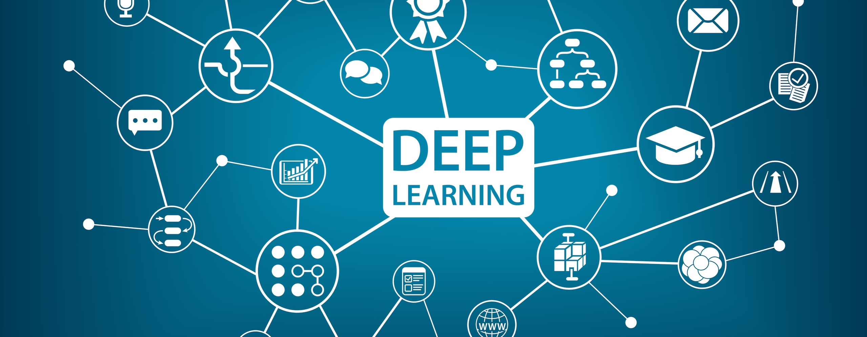
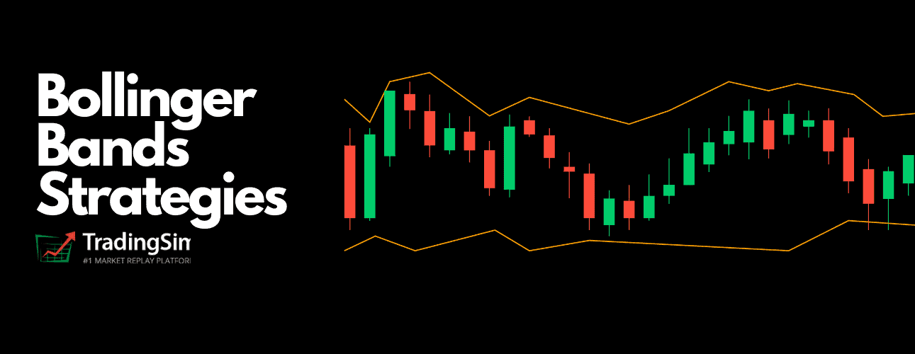

Traditional Trading Methods
Struggle To Adapt
Background & Motivation
24/7 Highly Volatile
Notes:
Good afternoon, professors. This is Nora. Today I’m glad to introduce my final year project to you and my topic is multi-agent synergistic framework for cryptocurrency investment.

Slide 5
Background & Motivation
Traditional Trading Methods
Struggle To Adapt
24/7 Highly Volatile
Notes:
Good afternoon, professors. This is Nora. Today I’m glad to introduce my final year project to you and my topic is multi-agent synergistic framework for cryptocurrency investment.

Slide 6
Background & Motivation
Traditional Trading Methods
Struggle To Adapt
Lack Transparency
Notes:
Good afternoon, professors. This is Nora. Today I’m glad to introduce my final year project to you and my topic is multi-agent synergistic framework for cryptocurrency investment.

Slide 7

Background & Motivation
Traditional Trading Methods
Struggle To Adapt
Lack Transparency
Cannot Explain
Notes:
Good afternoon, professors. This is Nora. Today I’m glad to introduce my final year project to you and my topic is multi-agent synergistic framework for cryptocurrency investment.

Slide 8
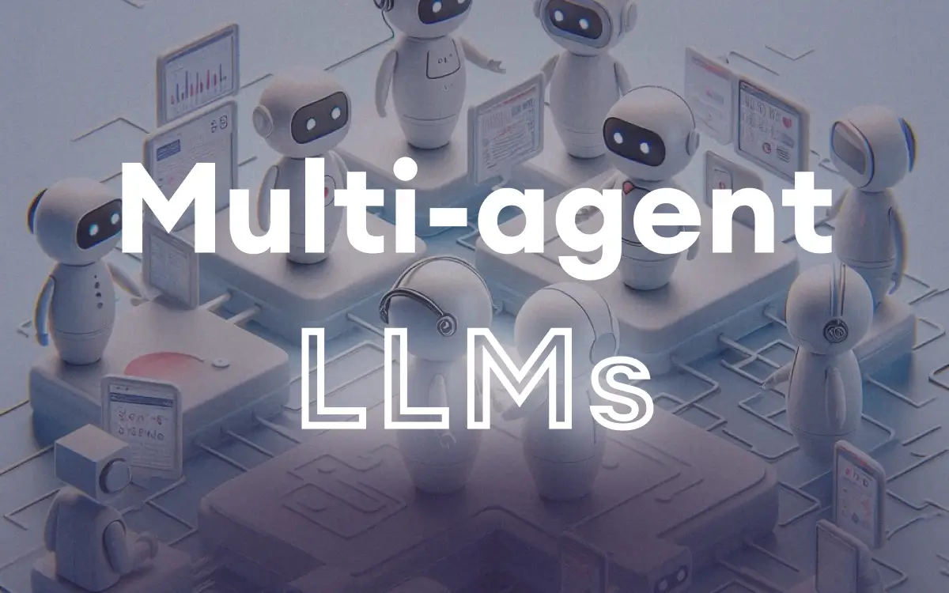
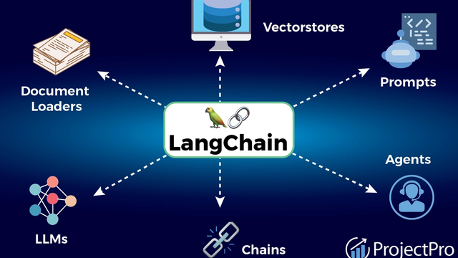
Traditional Trading Methods
Struggle To Adapt
Lack Transparency
Cannot Explain
Motivation & Background
Institutional Asset Management
Inaccessible & Unaffordable
Notes:
Good afternoon, professors. This is Nora. Today I’m glad to introduce my final year project to you and my topic is multi-agent synergistic framework for cryptocurrency investment.

Slide 9

Motivation & Background
Multi Agent Framework
Bridge The Gap & Affordable
Notes:
Good afternoon, professors. This is Nora. Today I’m glad to introduce my final year project to you and my topic is multi-agent synergistic framework for cryptocurrency investment.

Slide 10

Methodology
Advanced Natural Language Processing
+
Robust Reasoning
||
Decision Transparency
The LLM Engine: DeepSeek - V 3.2
Notes:
Good afternoon, professors. This is Nora. Today I’m glad to introduce my final year project to you and my topic is multi-agent synergistic framework for cryptocurrency investment.

Slide 11
Methodology
Advanced Natural Language Processing
+
Robust Reasoning
||
Decision Transparency
The LLM Engine: DeepSeek - V 3.2
Notes:
Good afternoon, professors. This is Nora. Today I’m glad to introduce my final year project to you and my topic is multi-agent synergistic framework for cryptocurrency investment.

Slide 12

Methodology
Advanced Natural Language Processing
+
Robust Reasoning
||
Decision Transparency
The LLM Engine: DeepSeek - V 3.2
Real World Asset
Management Team
Notes:
Good afternoon, professors. This is Nora. Today I’m glad to introduce my final year project to you and my topic is multi-agent synergistic framework for cryptocurrency investment.

Slide 13
Methodology
Real World Asset
Management Team
Notes:
Good afternoon, professors. This is Nora. Today I’m glad to introduce my final year project to you and my topic is multi-agent synergistic framework for cryptocurrency investment.

Slide 14
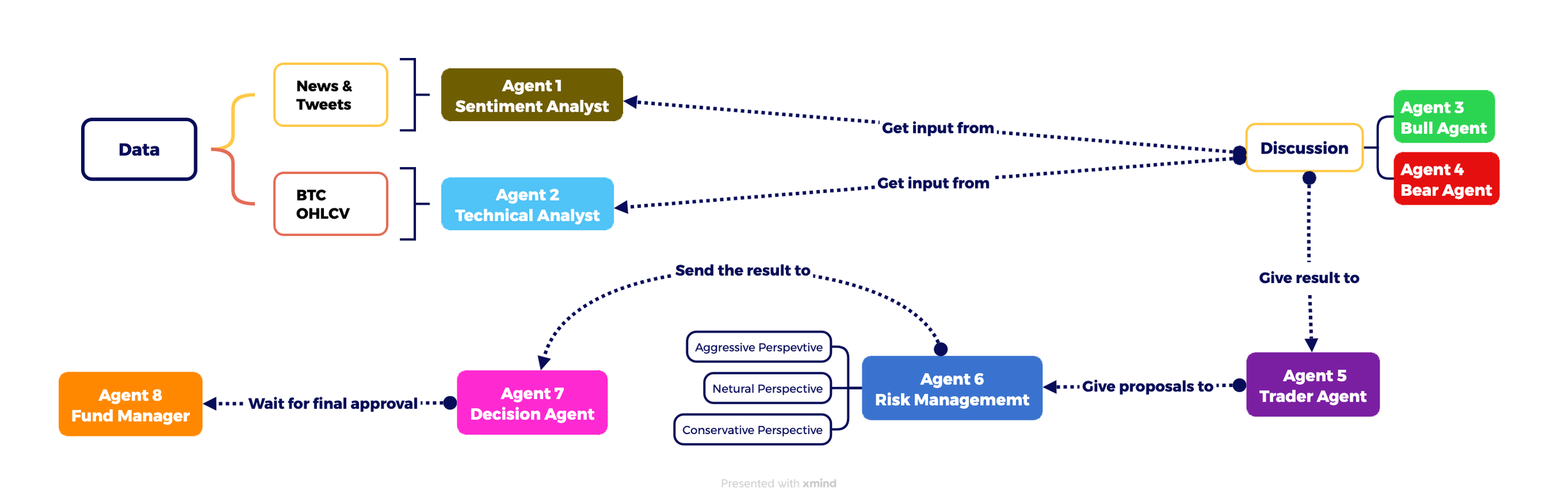
Methodology
Multi Agent Asset Management Team
Notes:
Good afternoon, professors. This is Nora. Today I’m glad to introduce my final year project to you and my topic is multi-agent synergistic framework for cryptocurrency investment.

Slide 15
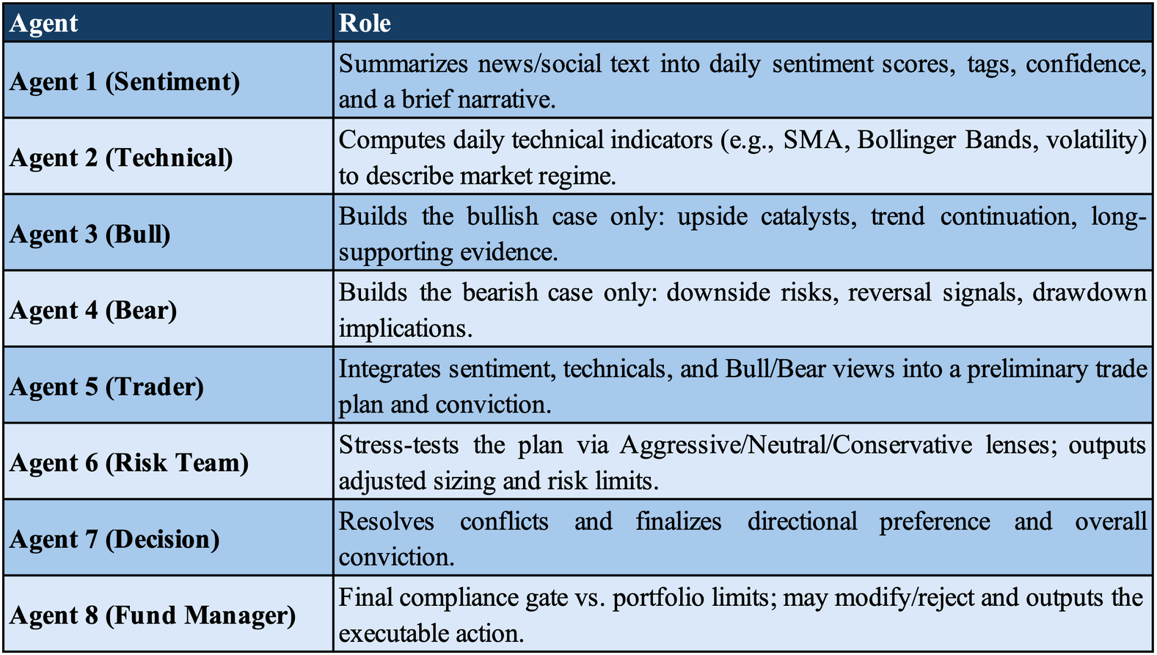
Methodology
Multi Agent Roles
FOUNDATION LAYER
ADVERSARIALLAYER
SYNTHESIS LAYER
EXECUTION LAYER
Notes:
Additionally, here comes a real-world pain point: as one of the retail investors, I know clearly how hard is for me to afford a professional quant team who can help me with crypto trading and risk management. Also, finding a quant team is expensive and most retail investors cannot meet the requirement for them to offer such service. That’s why I’m thinking about using AI to replace the quant team to lower the barrier for cypto trading and asset management.

Slide 16
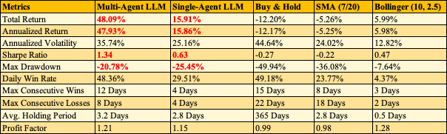
RESULT & ANALYSIS
OVERALL PERFORMANCE
Core Metrics:
  Total Return: 48.09% (Multi-Agent) vs. Baseline Strategies (Negative).
  Maximum Drawdown: -20.78% (LLM) vs. -49.94% (B&H) & -36.08% (SMA).
Notes:
Now let me show you my result and do the analysis.
In the evaluation period the multi‑agent framework achieved a total return of 22.64% while baseline strategies were negative, and the maximum drawdown was limited to –12.92% compared with –49.94% for buy‑and‑hold, which indicates the system’s ability to preserve capital through volatile phases rather than relying on extreme leverage to chase returns.

Slide 17
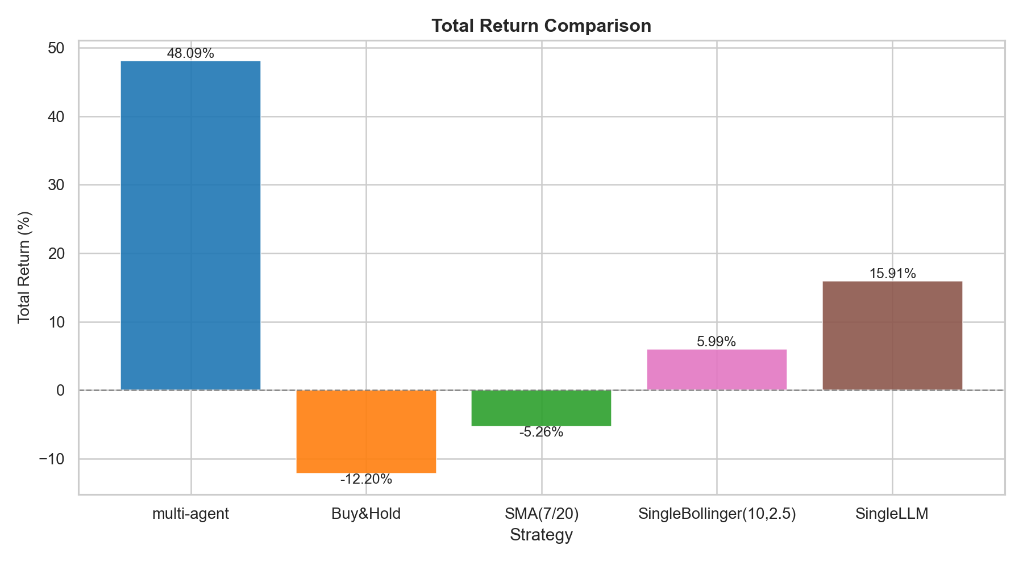
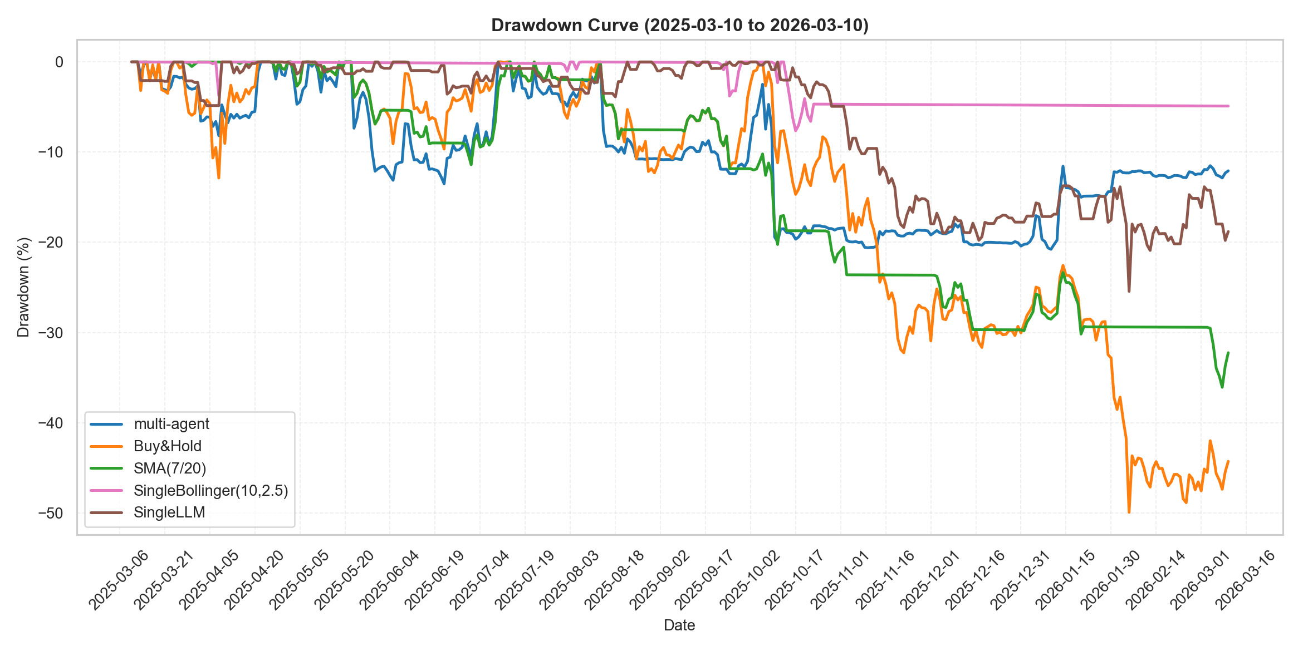
  Total Return: 48.09%
Notes:
Now let me show you my result and do the analysis.
In the evaluation period the multi‑agent framework achieved a total return of 22.64% while baseline strategies were negative, and the maximum drawdown was limited to –12.92% compared with –49.94% for buy‑and‑hold, which indicates the system’s ability to preserve capital through volatile phases rather than relying on extreme leverage to chase returns.

Slide 18
  Maximum Drawdown: -20.78%
Notes:
Now let me show you my result and do the analysis.
In the evaluation period the multi‑agent framework achieved a total return of 22.64% while baseline strategies were negative, and the maximum drawdown was limited to –12.92% compared with –49.94% for buy‑and‑hold, which indicates the system’s ability to preserve capital through volatile phases rather than relying on extreme leverage to chase returns.

Slide 19
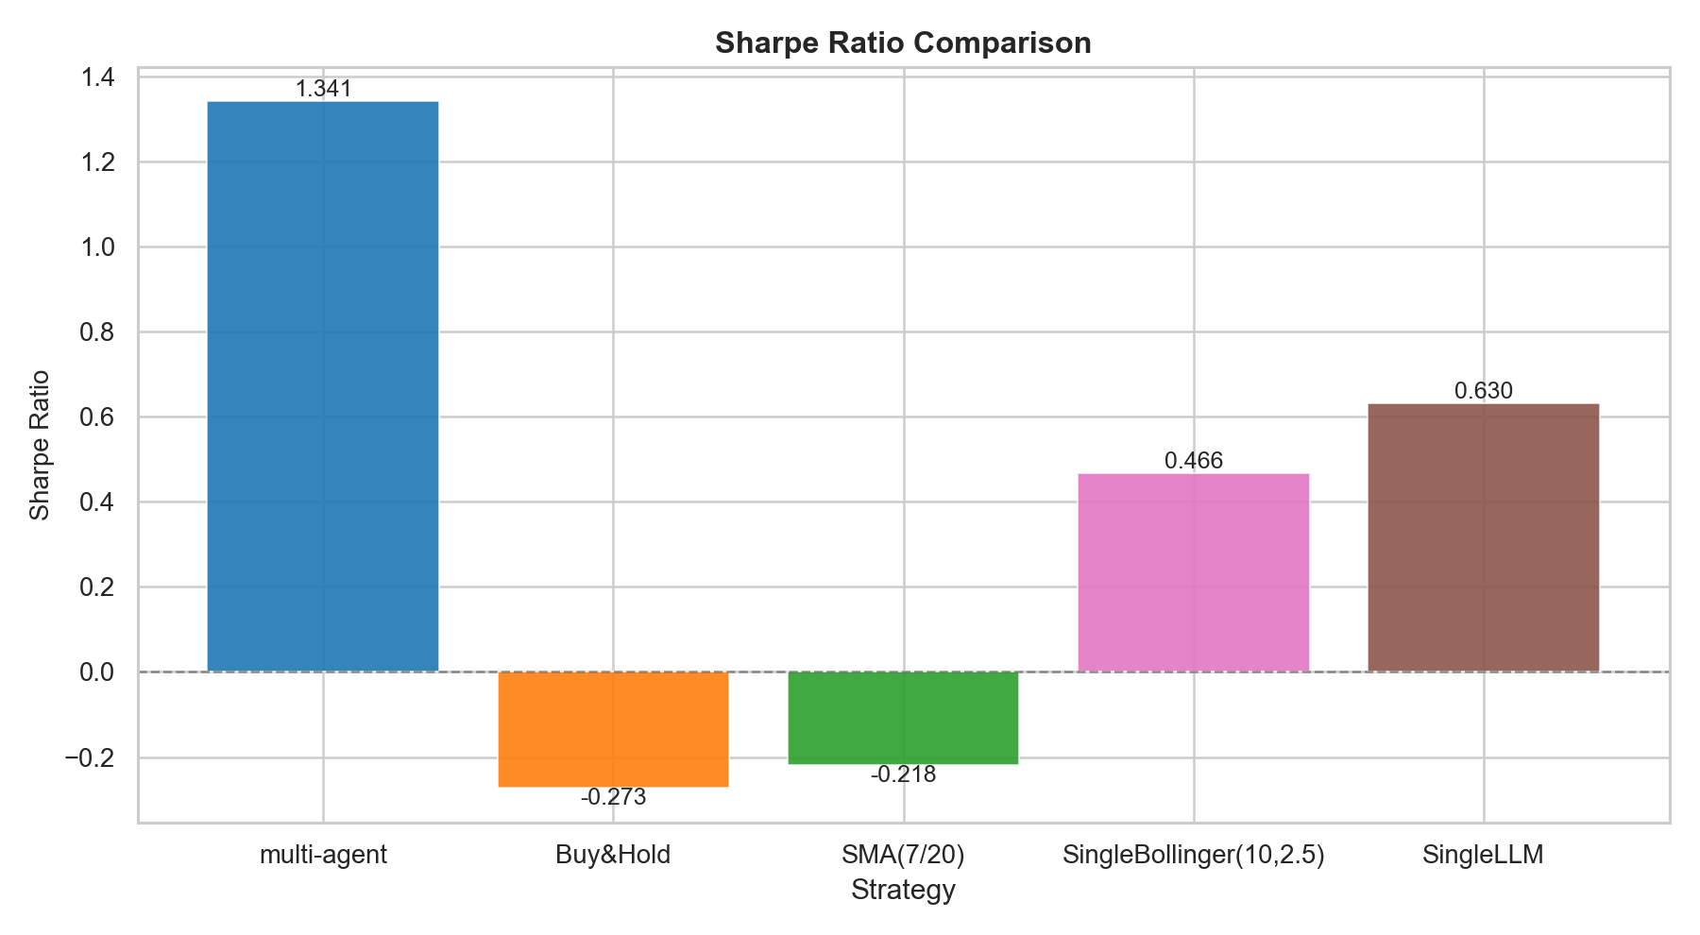
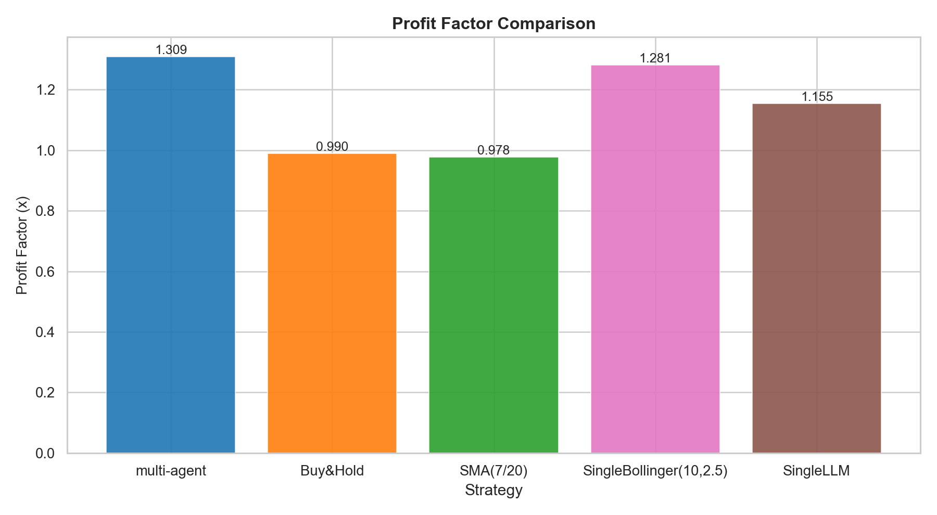
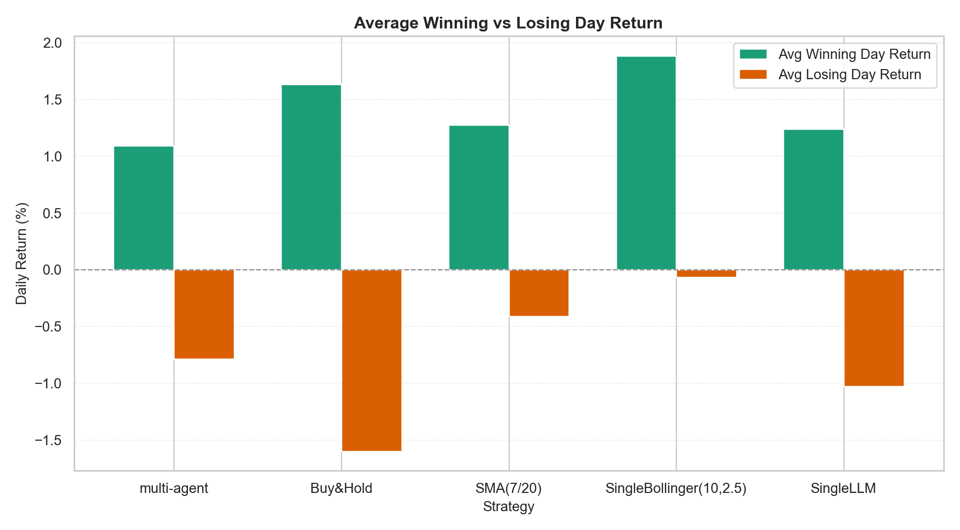
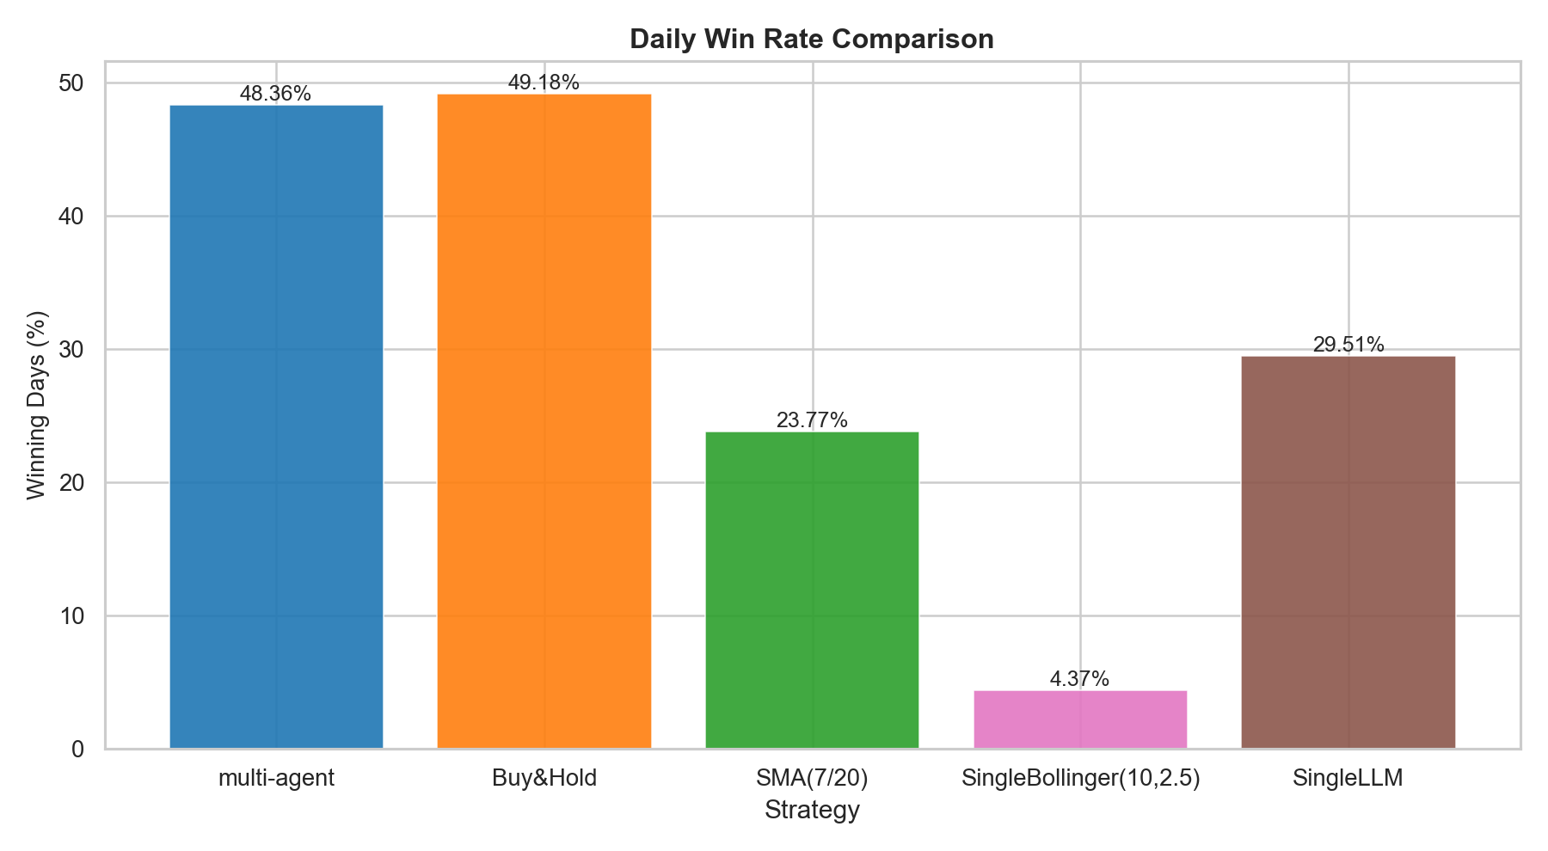
RESULT & ANALYSIS
RISK-ADJUSTED QUALITY & ASYMMETRY
Profit Factor: 1.309
Avg Winning Day Return: 1.21%
Notes:
Risk‑adjusted metrics include a Sharpe ratio of 1.193 and a daily win rate of 48.36%; the performance comes from favorable return asymmetry—average winning days of +0.72% versus losing days of –0.56%

Slide 20
RESULT & ANALYSIS
RISK-ADJUSTED QUALITY & ASYMMETRY
Profit Factor: 1.309
Avg Winning Day Return: 1.21%
Daily Win Rate: 48.36%
Notes:
Risk‑adjusted metrics include a Sharpe ratio of 1.193 and a daily win rate of 48.36%; the performance comes from favorable return asymmetry—average winning days of +0.72% versus losing days of –0.56%

Slide 21
RESULT & ANALYSIS
RISK-ADJUSTED QUALITY & ASYMMETRY
Avg Winning Day Return: 1.21%
Daily Win Rate: 48.36%
Sharpe Ratio: 1.341
Notes:
Risk‑adjusted metrics include a Sharpe ratio of 1.193 and a daily win rate of 48.36%; the performance comes from favorable return asymmetry—average winning days of +0.72% versus losing days of –0.56%

Slide 22
RESULT & ANALYSIS
RISK-ADJUSTED QUALITY & ASYMMETRY
Daily Win Rate: 48.36%
Sharpe Ratio: 1.341
Notes:
Risk‑adjusted metrics include a Sharpe ratio of 1.193 and a daily win rate of 48.36%; the performance comes from favorable return asymmetry—average winning days of +0.72% versus losing days of –0.56%

Slide 23
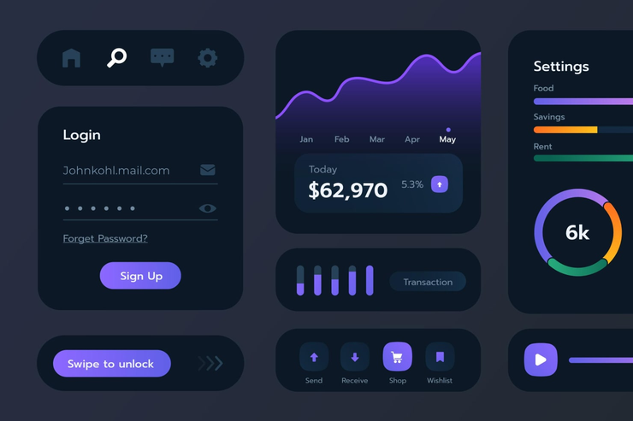
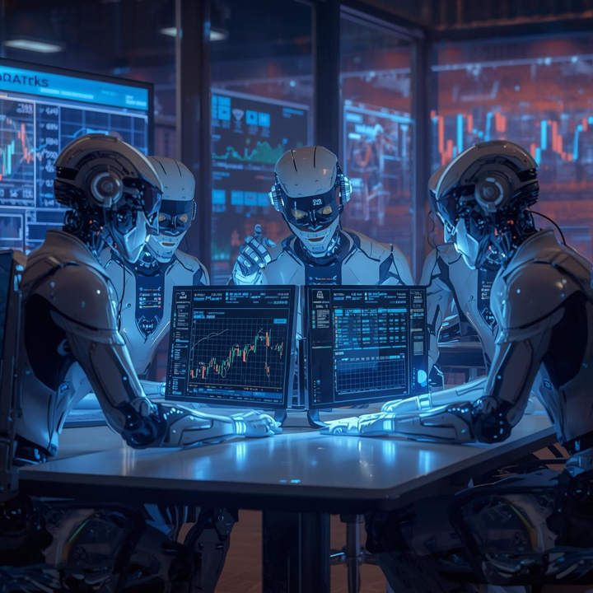
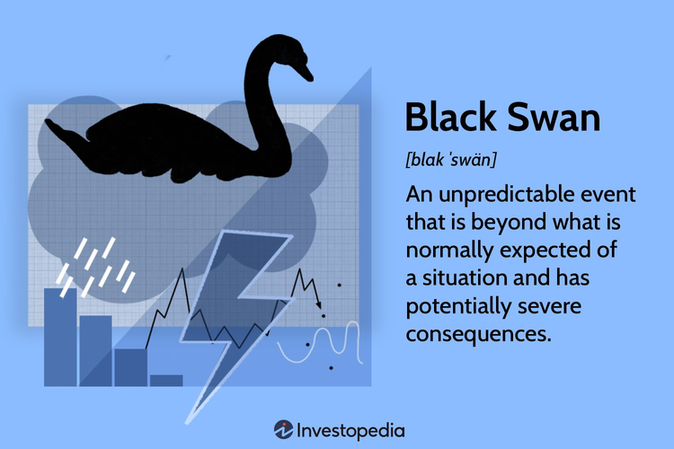
FUTURE DIRECTION
SaaS & User Experience
Self-Reflection Mechanism
Black Swan Prediction Module
Notes:
First of all...Current system runs as backend code. The ultimate vision is to build a user-friendly web or mobile application. Users can choose the type of trading asset and require the agent team to give personalized AI strategies according to their preferred investment style.
Second...I plan to implement a feature where the AI can review its own past trading history. If it made a poor decision that resulted in a loss, the system will analyze the mistake, adjust its own parameters, and learn from it.
Thirdly...Inspired by previous hackathons using LLMs to predict crises like pandemics and droughts, I'm thinking about training a specialized agent to monitor macro-economic anomalies and extreme outliers in order to detect potential risks earlier and protect the user’s funds before the disaster strikes.

Slide 24
FUTURE DIRECTION
SaaS & User Experience
Self-Reflection Mechanism
Black Swan Prediction Module
Notes:
First of all...Current system runs as backend code. The ultimate vision is to build a user-friendly web or mobile application. Users can choose the type of trading asset and require the agent team to give personalized AI strategies according to their preferred investment style.
Second...I plan to implement a feature where the AI can review its own past trading history. If it made a poor decision that resulted in a loss, the system will analyze the mistake, adjust its own parameters, and learn from it.
Thirdly...Inspired by previous hackathons using LLMs to predict crises like pandemics and droughts, I'm thinking about training a specialized agent to monitor macro-economic anomalies and extreme outliers in order to detect potential risks earlier and protect the user’s funds before the disaster strikes.

Slide 25
FUTURE DIRECTION
SaaS & User Experience
Self-Reflection Mechanism
Black Swan Prediction Module
Notes:
First of all...Current system runs as backend code. The ultimate vision is to build a user-friendly web or mobile application. Users can choose the type of trading asset and require the agent team to give personalized AI strategies according to their preferred investment style.
Second...I plan to implement a feature where the AI can review its own past trading history. If it made a poor decision that resulted in a loss, the system will analyze the mistake, adjust its own parameters, and learn from it.
Thirdly...Inspired by previous hackathons using LLMs to predict crises like pandemics and droughts, I'm thinking about training a specialized agent to monitor macro-economic anomalies and extreme outliers in order to detect potential risks earlier and protect the user’s funds before the disaster strikes.

Slide 26
CONCLUSION
This framework represents a significant step towards democratizing professional asset management. It offers a more intelligent, transparent, and accessible approach for navigating the complexities of cryptocurrency investment.
SaaS & User Experience
Self-Reflection Mechanism
Notes:
First of all...Current system runs as backend code. The ultimate vision is to build a user-friendly web or mobile application. Users can choose the type of trading asset and require the agent team to give personalized AI strategies according to their preferred investment style.
Second...I plan to implement a feature where the AI can review its own past trading history. If it made a poor decision that resulted in a loss, the system will analyze the mistake, adjust its own parameters, and learn from it.
Thirdly...Inspired by previous hackathons using LLMs to predict crises like pandemics and droughts, I'm thinking about training a specialized agent to monitor macro-economic anomalies and extreme outliers in order to detect potential risks earlier and protect the user’s funds before the disaster strikes.

Slide 27
THANKS!
MULTI-AGENT SYNERGISTIC FRAMEWORK FOR CRYPTOCURRENCY INVESTMENT
Q & A

